Slide 1


Heat-Responsive Microgel Anti-Foulant Coatings for Water Purification Membranes
Andrea Kraetz¹, Kaushik Londhe¹, Wendy Lin¹, Monish Manghnani¹, Douglas Rice², Lenore Dai¹, Francois Perreault², Mary Laura Lind Thomas¹
¹School for Engineering of Matter, Transport, and Energy, Arizona State University
²School of Sustainable Engineering and the Built Environment, Arizona State University

Slide 2
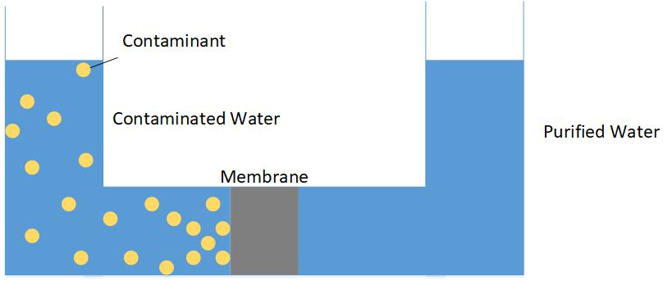
Reverse Osmosis
Pressure
Osmotic Gradient
Desired Flow
Notes:
-Introduce need for water purification
-Flux of water through membrane –amount of permeate per unit area of membrane per unit time
-importance of the membrane in the process
-structure of membrane
-Transition to foulants
Applied pressure forces contaminated water through membrane.
Membrane structure allows water through, but prevents the flow of contaminants.
Structure of the membrane determines selectivity.
Flux of the membrane is the amount of water through the membrane per area per time.

Slide 3
Fouling
Notes:
Balance of antifouling coatings to flux
Antifoulant types
As contaminants build up on one side of the membrane, it produces a layer on the membrane surface.
Fouling layer prevents water from traveling through membrane.
Reduces the flux of the membrane and requires additional pressure to push water through, reducing efficiency.
Anti-fouling coatings are being developed to prevent this.

Slide 4
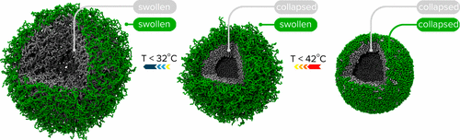
Microgel
¹F. A. Plamper and W. Richtering, "Functional Microgels and Microgel Systems," Accounts of Chemical Research, vol. 50, no. 2, pp. 131-140, 2017.
Notes:
Explain colloidal
Colloidal substance that is highly responsive to outside stimuli.
Shrinks at higher temperature.
Microgel can be used as an anti-foulant coating through functional group binding to foulant and as a physical barrier between the foulants and the membrane surface.
When it shrinks in higher temperatures, foulants on the microgel will be removed.

Slide 5
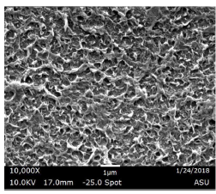
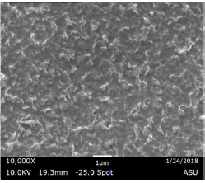
Microgel Coating
After Dip-coating

Slide 6
Experimental Approach
Coated membrane with fluorescent bovine serum albumin (BSA)
Exposed membrane surface to heated water in cross flow (60°C) at low flow rate (0.4L/h) under fluorescent microscopy
Notes:
Images taken from microscope
ImageJ to analyze fluorescent intensity

Slide 7
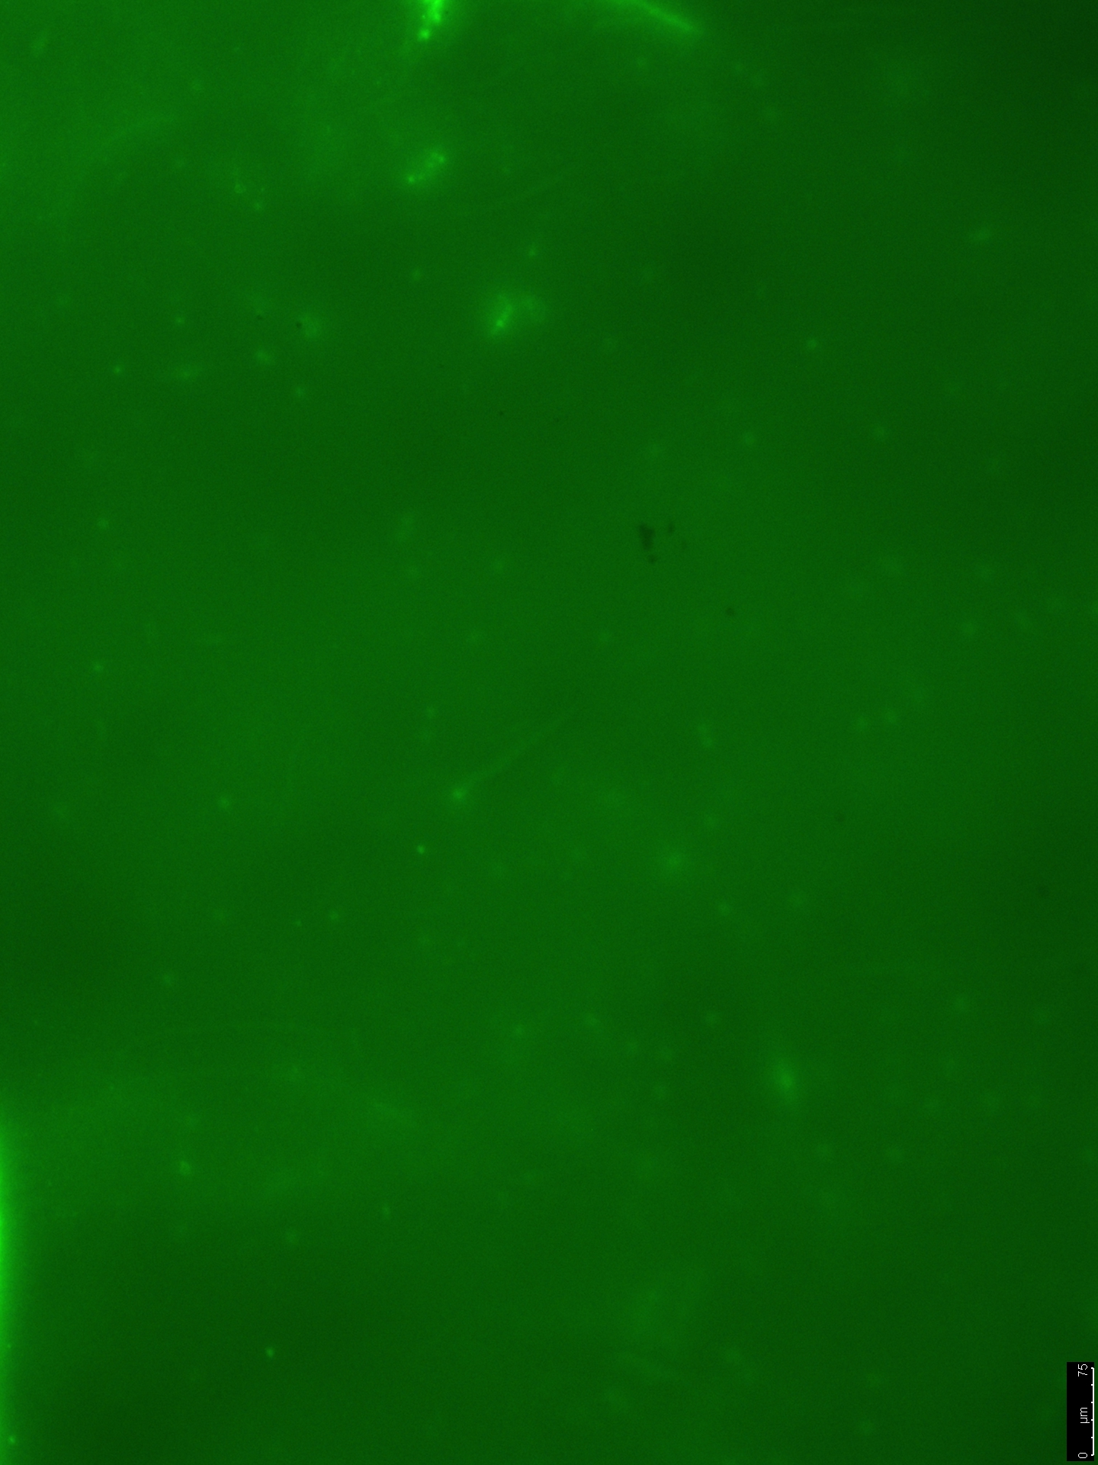
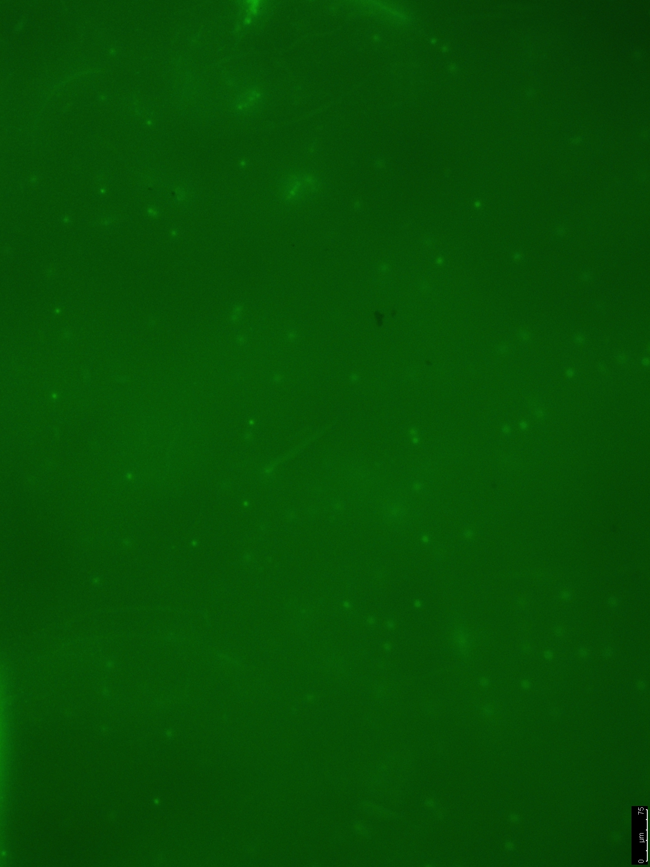
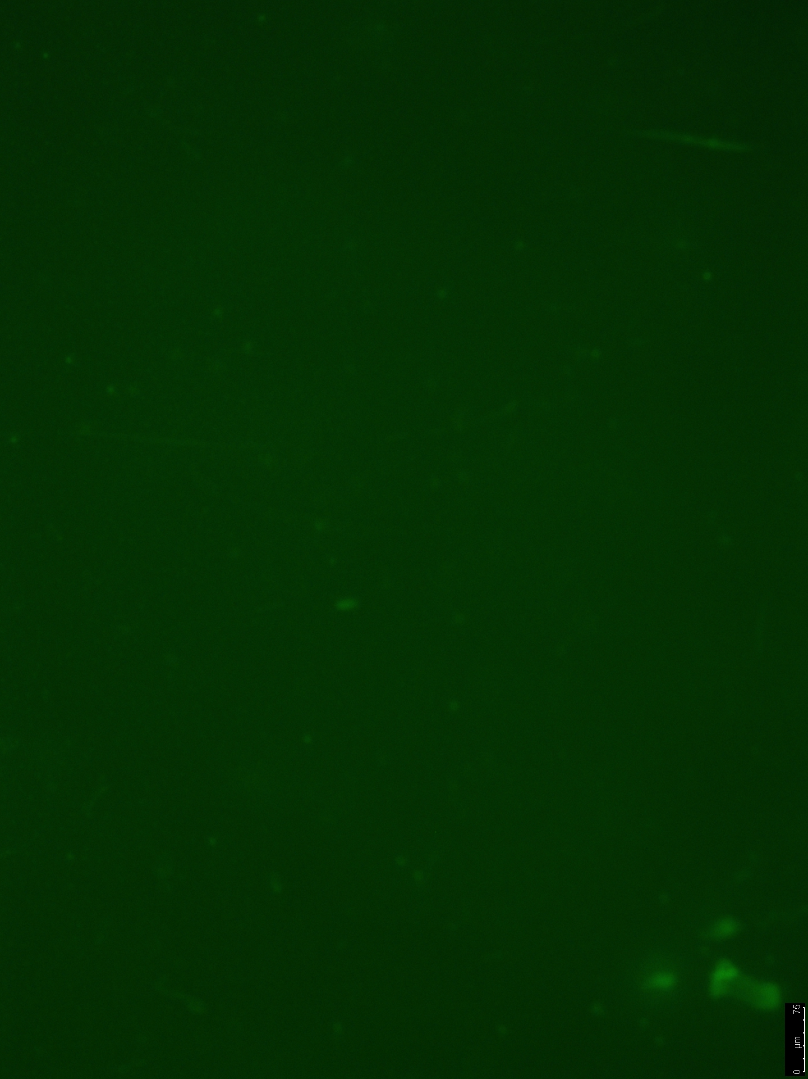
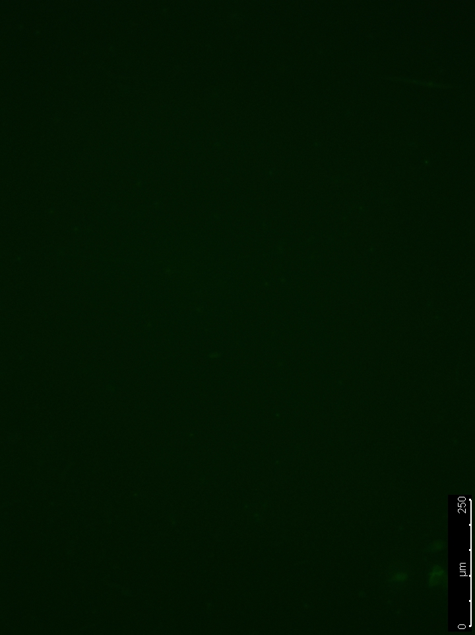
Results
Bare Membrane without Microgel
Microgel Coated Membrane
After 20min Heated Crossflow
After 20min Heated Crossflow
7.3% Fluorescence Decrease
43.8% Fluorescence Decrease

Slide 8
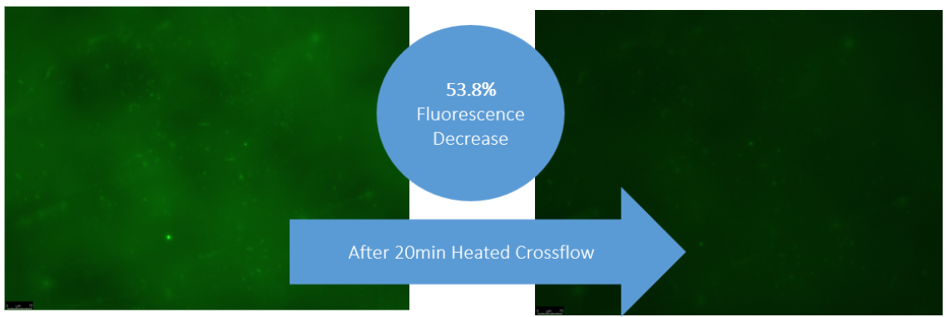
Membrane Functionalization
Under reverse osmosis, microgel detached from the membrane surface due to high pressures.
A functionalization process was implemented to bond the microgel to the membrane surface, but the functionalization could effect the performance of the membrane.
8a
8b
Figure 8. Image of functionalized microgel membrane with fluorescent BSA with a) the initial amount of fluorescence and b) the amount after 20 minutes of hot water

Slide 9
Future Work
Conduct reverse osmosis tests on the functionalized membranes to determine if the microgel remains in the surface under these conditions.
Test microgel performance with various foulants.
Develop additional methods for the uniform coating of microgel on membrane.
Notes:
Summarize the what I’ve done and how it applies to what I want to do in the future

Slide 10

Acknowledgements
The Lind Lab: Dr. Mary Laura Lind
  Kaushik Londhe
Dr. François Perreault & Doug Rice
Dr. Lenore Dai & Wendy Lin
The ASU/NASA Space Grant Program
W.L. Gore & Associates
Notes:
MLL: for the advice and resources she has provided me with and for the many hours she has spent reviewing my work.
Grad students: spent time developing experiments and training me.
FP: for his assistance and for the use of his laboratory and equipment.
LD: for her expertise and the use of her microgel.

Slide 11
Thank you!
Questions?

